Slide 1



Price List: 2026-27
1 OR 2 YEAR EXAMINED PROGRAMMES
SHORT NON-EXAMINED PROGRAMMES
USEFUL INFORMATION FOR SHORT-TERM PROGRAMMES
SEPTEMBER 2026
SEPTEMBER 2026
January 2027
One Academic Year
Arrival: 27th August 2026
Departure: 26th June 2027
Tuition £ 9,780
Homestay £ 7,900
Enrichment Fee £ 450
Admin Fee £ 250
Total: £ 18,380
Year 1 –AS Level. Option to continue to Year 2 with tuition fees remaining at the same price. Other prices are subject to change in accordance with inflation.
Autumn Term
Arrival: 27th August 2026
Departure: 19th December 2026
Tuition £ 4,350
Homestay £ 2,975
Enrichment Fee £ 300
Admin Fee £ 250
Total: £ 7,950
Spring Term
Arrival: 10th January 2027
Departure: 3rd April 2027
Tuition £ 3,800
Homestay £ 2,200
Enrichment Fee £ 300
Admin Fee £ 250
Total: £ 6,550
For direct applicants, a non-refundable deposit of £500 is payable when you accept an offer of a place for a short non-examined programme. Our refund policy is available on our website.
Half-board homestay accommodation includes breakfast and dinner during the week and, if required, lunch at weekends, During the Christmas and Easter holiday’s accommodation will be full-board.
We charge an additional £100 homestay supplement during Christmas and Easter holidays. This is included in the price.
Any of the following special dietary requirements will incur a supplement of £20 per week: gluten free; coeliac; dairy free; lactose free; vegan; Halal. Other dietary requirements not listed above, may still incur an additional supplement.
The age range for our courses is 16-18 years at enrolment. Students should have a strong B1/ IELTS 5.0, but formal qualifications are not required. All students must meet our entry requirements.
Please note that some courses may have additional costs for materials or equipment and we will always try to quote this before travel.
There are no refunds on enrichment if students choose not to attend.
Our prices do not include medical or travel insurance.
Semester 1
Arrival: 27th August 2026
Departure: 30th January 2027
Tuition £ 4,955
Homestay £ 4,125
Enrichment Fee £ 350
Admin Fee £ 250
Total: £ 9,680
Semester 2/ Pre- A Level
Arrival: 10th January 2027
Departure: 22nd May 2027
Tuition £ 4,540
Homestay £ 3,425
Enrichment Fee £ 350
Admin Fee £ 250
Total: £ 8,565
USEFUL INFORMATION FOR LONG-TERM PROGRAMMES
For direct applicants, a non-refundable deposit of £2,000 is payable when you accept an offer of a place for a one-or two-year programme & visa paperwork will not be issued until payment in full for the programme is received. Our refund policy is available on our website.
Please be aware that we reserve the right to complete a compliance check on all applicants requiring a Student Route visa (a programme longer than 6 months).
The age range for our courses is 16-18 years at enrolment.
All students must meet our entry requirements.
Tuition fee prices are held for year 2 of the A Level Programme. However, we reserve the right to increase the half board homestay fee in line with inflation for the second year of the two-year programme.
Extension Fee:
Students can extend their stay up to six months visa-free, and can even extend up to two years, subject to visa clearance. Please enquire for further details.
Term Dates
TERM | START DATE | END DATE
Autumn 2026 | 27th August 2026 | 18th December 2026
Half Term: 26th Oct – 30th Oct 2026
Spring 2027 | 4th January 2027 | 26th March 2027
Half Term: 15th Feb – 19th Feb 2027
Summer 2027 | 12th April 2027 | 25th June 2027
Half Term: 31st May – 4th June 2027
Itchen Sixth Form College | Middle Road |
Southampton | UK | SO19 7TB
T: +44 (0)2380 435636 (option 3)
E: international@itchen.ac.uk
Disclaimer: All information is correct at the time of going to press. Please use this price list as a guide only. Last amended 13/06/2025

Slide 2
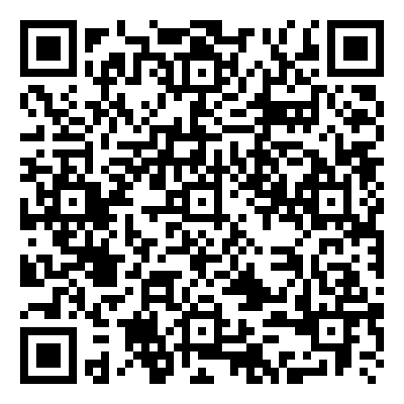
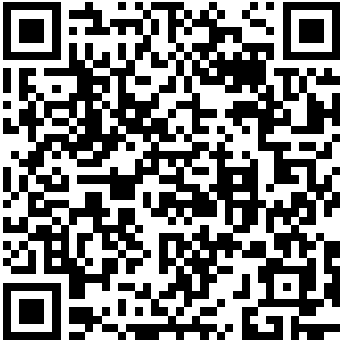
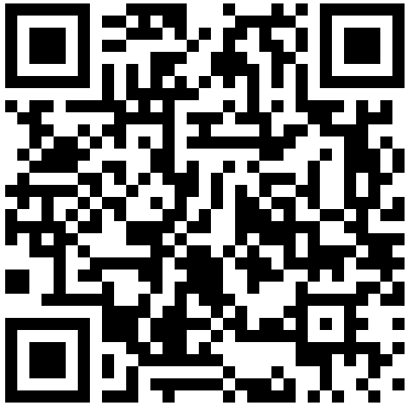
Price List: 2026-27
ACCESS TO HIGHER EDUCATION PROGRAMMES
TRANSNATIONAL
EDUCATION
GROUP STUDY
TOURS
Optional Extras
Access to Higher Education
Arrival: 27th August 2026
Departure: 26th June 2027
Tuition (36 Weeks) £ 11,580
Admin Fee £ 500
Total: £ 12,080
Programme includes Access to Higher Education, ESOL and Study Skills, and is accredited by Ascentis.
Discover More:
Accommodation not included on this programme
Transnational Education
Contracts from September to July
Education consultancy programme, supporting the development of whole-institution learning, ensuring quality and consistency in line with UK educational standards.
Curriculum Consultancy
Teaching and Learning CPD
Tailored Development Plan
Price on request.
Discover More:
Enquire Here:
Group Study Tours
Year-round enrolment
1-8 weeks
A taste of high school, giving groups the opportunity to experience Itchen College and the UK on a tailored itinerary, from anywhere between one and eight weeks.
Homestay Accommodation
A Level and Level 3 Lessons
Bespoke Trips and Activities
Price on request.
Discover More:
Enquire Here:
Report Convalidation £100
IELTS Entry £250
IELTS for UKVI Entry £275
Return Airport Transfer* FREE
Itchen College Hoody FREE
*Return airport transfers from/to London Gatwick and London Heathrow airports are included in our prices. Transfers to and from other airports will incur additional charges.
Scan, tap, or click QR code
Clickable QR CODE
Scan, tap, or click QR code
Scan, tap, or click QR code
Clickable QR CODE
Scan, tap, or click QR code
Scan, tap, or click QR code
USEFUL INFORMATION FOR NEW PROGRAMMES
Access to Higher Education Programmes include Allied Health Professions and Primary Teaching
For direct applicants, a non-refundable deposit of £2,000 is payable when you accept an offer of study & visa paperwork will not be issued until payment in full for the programme is received. Our refund policy is available on our website.
We reserve the right to complete a compliance check on all applicants requiring a Student Route visa.
The age range for our courses is 18-25 years at enrolment.
Itchen Sixth Form College | Middle Road |
Southampton | UK | SO19 7TB
T: +44 (0)2380 435636 (option 3)
E: international@itchen.ac.uk
Disclaimer: All information is correct at the time of going to press. Please use this price list as a guide only. Last amended 13/06/2025

